Slide 1
Software Design for Cloud 2.2
Python Programming
Lecture 4
Sets, Maps, Dictionaries and Iterators

Slide 2
List – Review
An ordered collection of Objects
list1= [1, 2, 3, 4, 5]
list2= [“Mon”, “Tues”, “Wed”, Thur”, “Fri”]
list3= [object1, object2, object3, object3]
N.B. Unlike traditional arrays - Can easily insert/ delete to/from centre of the list

Slide 3
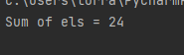
List
def main():
list1= [2, 5, 2, 8, 7]
result = myAdd(list1)
print('Sum of els = {0}'.format( result))
def myAdd(listp):
result = 0
for el in listp:
result = result + el
return result
main()

Slide 4
List (Alternative Implementation)
def main():
list1= [2, 5, 2, 8, 7]
result = myAdd2(list1)
print('Sum of els = {0}'.format( result))
def myAdd2(listp):
result = 0
for index in range(0, len(listp)):
result = result + listp[index]
return result
main()

Slide 5
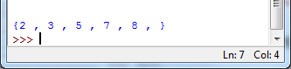
Set – Unordered List, no Duplicates
def main():
set1 = {2, 5, 2, 8, 7, 3, 2, 5}
printSet(set1)
def printSet(setp):
print("\n{",end='')
for el in setp:
print(el,", ",end='')
print("}")
main()

Slide 6
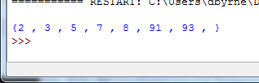
Union
def main():
set1 = {2, 5, 2, 8, 7, 3, 2, 5}
set2 = {2, 5, 91, 93}
set3 = set1.union(set2)
printSet(set3)
def printSet(setp):
print("\n{",end='')
for el in setp:
print(el,", ",end='')
print("}")
main()

Slide 7
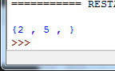
Intersection
def main():
set1 = {2, 5, 2, 8, 7, 3, 2, 5}
set2 = {2, 5, 91, 93}
set3 = set1.intersection(set2)
printSet(set3)
def printSet(setp):
print("\n{",end='')
for el in setp:
print(el,", ",end='')
print("}")
main()

Slide 8
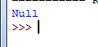
Checking If a set is Empty
def main():
set1 = {2, 5, 2, 8, 7, 3, 2, 5}
set2 = {29, 59, 91, 93}
set3 = set1.intersection(set2)
checkEmpty(set3)
def checkEmpty(setp):
if (len(setp)==0):
print('Null');
else:
print ('Not Empty')
main()

Slide 9
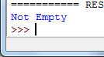
Checking If a set is Empty
def main():
set1 = {2, 5, 2, 8, 7, 3, 2, 5}
set2 = {2,5, 29, 59, 91, 93}
set3 = set1.intersection(set2)
checkEmpty(set3)
def checkEmpty(setp):
if (len(setp)==0):
print('Null');
else:
print ('Not Empty')
main()

Slide 10
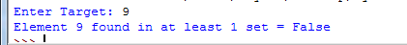
Ex241_ Complete method mySearch Ex241_skel.py
def main():
set1= {2, 5, 2, 8, 7}
set2= {1,2,3,4}
target = int(input('Enter Target: '))
result = mySearch(set1,set2, target)
print('Element {0} found in at least 1 set = {1}'.format(target, result))
def mySearch(setp1,setp2, tar):
result = False
return result
main()
mySearch({2, 5, 2, 8, 7}, {1,2,3,4}, 8) = True

Slide 11
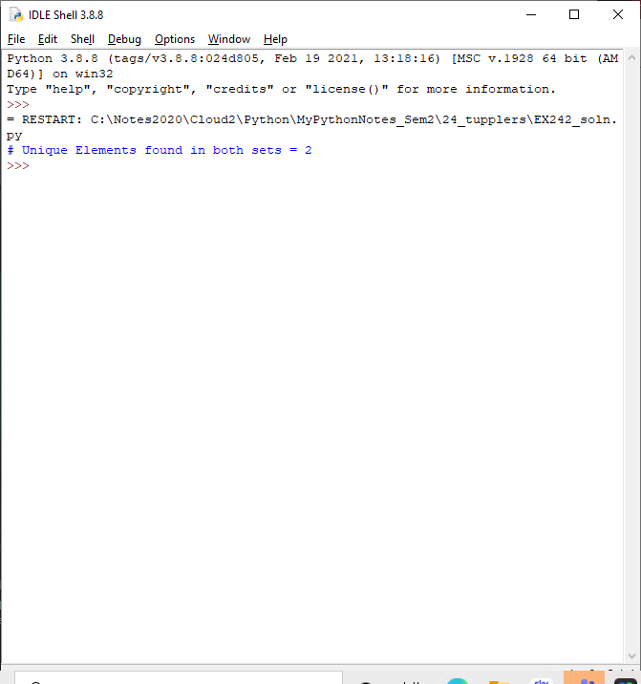
Ex242_ Complete method countBoth Ex242_skel.py
def main():
set1= {2, 5, 2, 8, 7}
set2= {1,2,3,4,5}
result = countBoth(set1,set2)
print('# Unique Elements found in both sets = {0}'.format( result))
def countBoth(setp1,setp2):
result = 0
return result
main()
countBoth({2, 5, 2, 8, 7}, {1,2,3,4,5}) = 2

Slide 12
Other set methods
s.add(x) # Add an El
s.remove(x) # Remove x from list
s.issubset(t)
len(s) # cardinarity of set
# contains x
if x in s:
print(‘Contains’,x)
if x not in s:

Slide 13
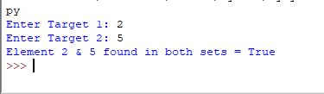
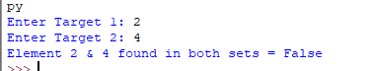
Ex243_ Complete method inBoth Ex243_skel.py
def main():
set1= {2, 5, 2, 8, 7}
set2= {1,2,3,4,5,6,7}
target1 = int(input('Enter Target 1: '))
target2 = int(input('Enter Target 2: '))
result = inBoth(set1,set2, target1, target2)
print('Element {0} & {1} found in both sets = {2}'.format(target1, target2, result))
def inBoth(setp1,setp2, tar1,tar2): result = 0
return True
main()
inBoth({2, 5, 2, 8, 7}, {1,2,3,4,5,6,7}, 2, 5) = True

Slide 14
Dictionaries Set of maplets key-> value studentList= {'Smith':58, 'Jones':36, 'peters':78, 'Adams':44}

Slide 15
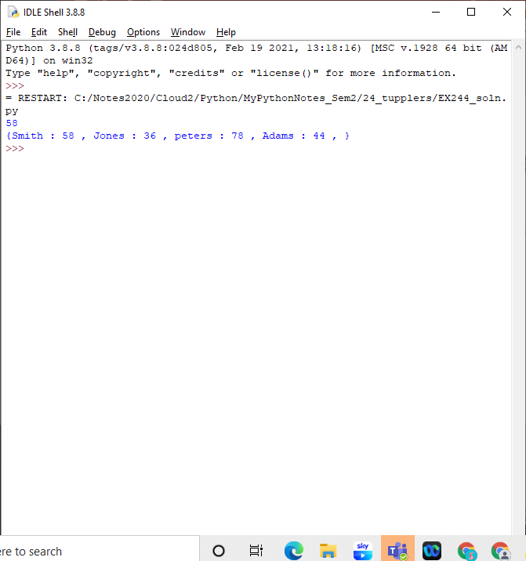
def main(): studentList= {'Smith':58, 'Jones':36, 'peters':78, 'Adams':44} print(studentList.get('Smith'))

Slide 16
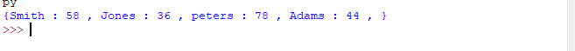
def main(): studentList= {'Smith':58, 'Jones':36, 'peters':78, 'Adams':44} printList(studentList) def printList(studentL): print('{',end='') for item in studentL.items(): print(item[0],':',item[1], ', ',end='') print('}') main()

Slide 17
def main(): studentList= {'Smith':58, 'Jones':36, 'peters':78, 'Adams':44} printList(studentList) def printList(studentL): print('{',end=‘’) for key, value in studentL.items(): print(key,':',value, ', ',end='') print('}') main()

Slide 18
Ex244_ Complete method highestMark Ex244_skel.py
def main():
#studentList= {'Smith':58, 'Jones':36, 'peters':78, 'Adams':44}
studentList= {'Smith':58, 'Jones':86, 'peters':78, 'Adams':44}
result= highestMark(studentList)
print('Student with highest mark={0}'.format(result))
def highestMark(studentL):
highest=0
name=‘’
return name
main()
highestMark({'Smith':58, 'Jones':36, 'peters':78, 'Adams’:44}) = peters
highestMark({'Smith':58, 'Jones’:86, 'peters':78, 'Adams’:44}) = Jones

Slide 19
Dictionary Methods
d.get(key) - returns associated value
d.keys() - returns all keys
d.values() - returns all values
{'python': 1, 'javascript': 2, 'csharp': 2}
sample_dict.update( {‘csharp’: 3 })
>print(sample_dict)
{'python': 1, 'javascript': 2, 'csharp': 3}
Sample_dict.update({‘C#’:5}) # adding a new element to the list

Slide 20
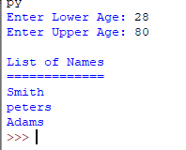
Ex245_ Complete method printInRange Ex245_skel.py
def main():
studentList= {'Smith':58, 'Jones':86, 'peters':78, 'Adams':44, 'Cross':25}
lower = int(input('Enter Lower Age: '))
upper = int(input('Enter Upper Age: '))
printInRange(studentList, lower,upper)
def printInRange(studentL, low,high):
print('\nList of Names')
print('=============')
main()

Slide 21
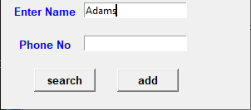
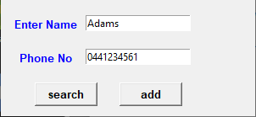
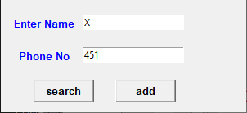
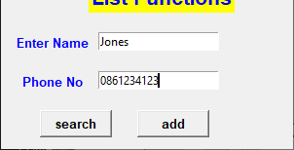
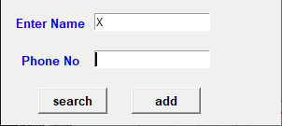

Ex246_ Complete methods printInRange
def findNumber(dict,key): def add(dict, key, value):

Slide 22
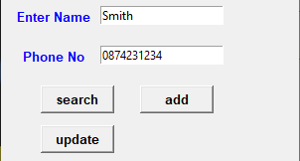
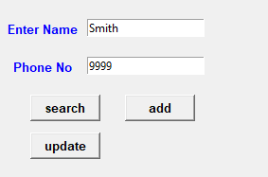
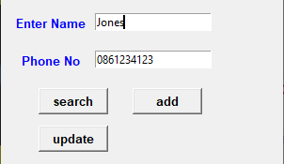
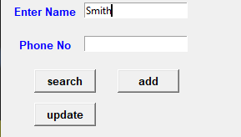
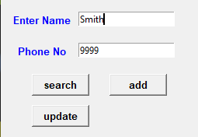
Ex247_ Add an update button
def update(dict, key, value):

